Slide 1
COFFEE SHOP SALES
DATA ANALYST PORTFOLIO PROJECT
POWER BI + MY SQL

Slide 2
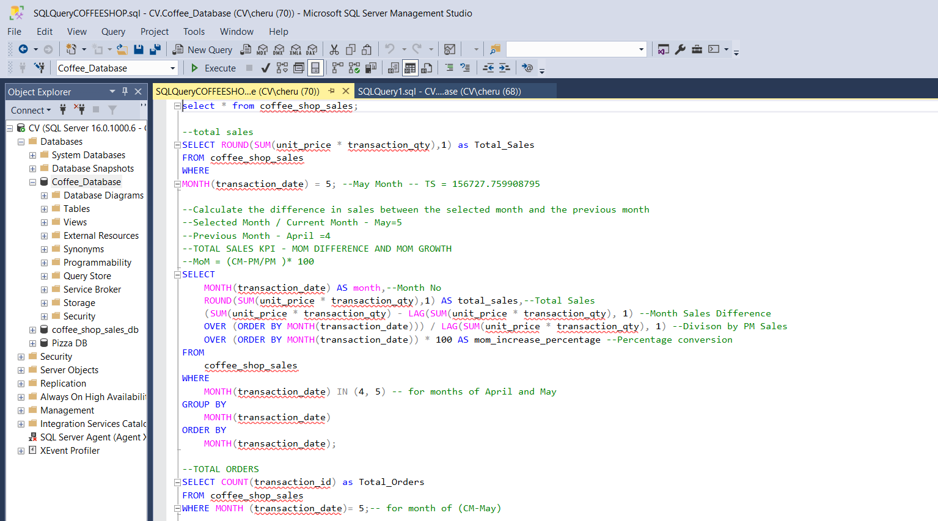
MY SQL
PART 1
FIRING THE SQL QUERIES TO SOLVE THE BUSINESS PROBLEMS

Slide 3
MY SQL
STEPS FOR MY SQL
Data Walkthrough
Raw data file preparation
Creating Database
Importing File
Cleaning Imported File
Changing Imported File
Firing SQL Queries for Business Requirements
Storing Results
Preparing SQL Documents

Slide 4
MY SQL
FUNCTIONALITIES LEARNT
STR_TO_DATE
ROUND
SUM
COUNT
AVG
LAG
MONTH
DAY
DAYOFWEEK
SELECT
ALIAS
MAX/MIN
HOUR
ALTER TABLE
UPDATE TABLE
CHANGE COLUMN
WHERE
GROUP BY
CASE
ORDER BY
LIMIT
WINDOW FUNCTION
JOINS
SUBQUERIES

Slide 5
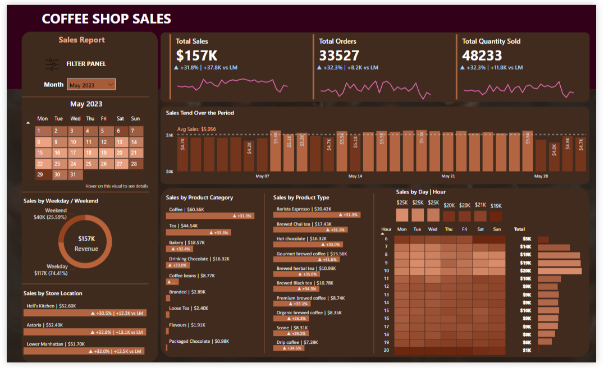
PART 2
POWER BI DASHBOARD

Slide 6
PROBLEM STATEMENTS
KPI’S REQUIREMENTS
Total Sales Analysis:
Calculate the total sales for each respective month.
Determine the month-on-month increase or decrease in sales.
Calculate the difference in sales between the selected month and the previous month.
Total Order Analysis:
Calculate the total number of orders for each respective month.
Determine the month-on-month increase or decrease in the number of orders.
Calculate the difference in the number of orders between the selected month and the previous month.
Total Quantity Sold Analysis:
Calculate the total quantity sold for each respective month.
Determine the month- on-month increase or decrease in the total quantity sold.
Calculate the difference in the total quantity sold between the selected month and the previous month.

Slide 7
PROBLEM STATEMENTS
CHARTS REQUIREMENTS
1. Calendar Heat Map :
Implement a calendar heat map that dynamically adjusts based on the selected month from a slicer
Each day on the calendar will be color-coded to represent sales volume, with darker shades indicating higher sales.
Implement tooltips to display detailed metrics(Sales, Orders, Quantity) when hovering over a specific day.
2. Sales Analysis by Weekdays and Weekends:
Segment sales data into weekdays and weekends to analyze performance variations.
Provide insights into whether sales patterns differ significantly between weekdays and weekends.
3. Sales Analysis by Store Location:
Visualize sales data by different store locations.
Include month-over-month (MoM) difference metrics based on the selected month in the slicer.
Highlight MoM sales increase or decrease for each store location to identify trends.

Slide 8
PROBLEM STATEMENTS
CHARTS REQUIREMENTS
4. Daily Sales Analysis with Average Line:
Display daily sales for the selected month with a line chart.
Incorporate an average line on the chart to represent the average daily sales.
Highlight bars exceeding or falling below the average sales to identify exceptional sales days.
5. Sales Analysis by Product Category:
Analyze sales performance across different product categories.
Provide insights into which product categories contribute the most to overall sales.
6. Top 10 Product by Sales:
Identify and display the top 10 products based on sales volume.
Allow users to quickly visualize the best-performing products in terms of sales.

Slide 9
PROBLEM STATEMENTS
CHARTS REQUIREMENTS
7. Sales Analysis by Days and Hours:
Utilize a heat map to visualize sales patterns by days and hours.
Implement tooltips to display detailed metrics ( Sales, Orders, Quantity ) when hovering over a specific day-hour.

Slide 10
Thank you

